Slide 1
AI 705:Recommendation Systems
Mini Project
MT2023119 :Deepanjali Ghosh
MT2023083 :H Anarghya
MT2023147:Anamika Mishra

Slide 2
Objective
The objective of this project is to build a movie recommendation system using the MovieLens 1M dataset, where based on the existing ratings of an user, and the new ratings entered by new user we suggest new movies that the user will like.
The following methods have been implemented:
Collaborative filtering
Singular Value Decomposition (SVD) and K-Means

Slide 3
Data Analysis:
Creation of Pivot Table:
From three data sets :users, ratings, movies(given),a pivot table is generated with userId as index ,movie title as column and ratings as value.
Count nans for each movie:
Most of the movies have a lot of nan values which we filled later using various technique.
Basic understanding of users:
Min rating is done by userId 1 which is 20
Max rating is done by userId 6040 which is 2314
Movie selection:
Only those movies which have received at least one rating are selected
Data Collection:
New users are prompted to rate the movies in a 1-5 scale

Slide 4
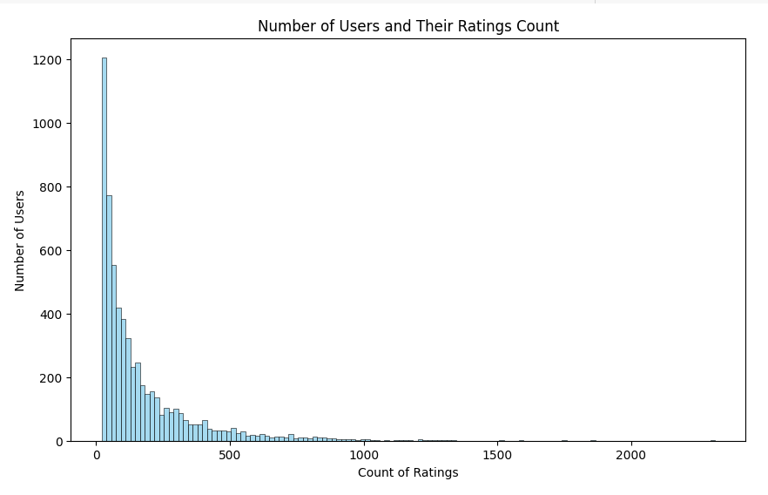
No of ratings count per user:

Slide 5
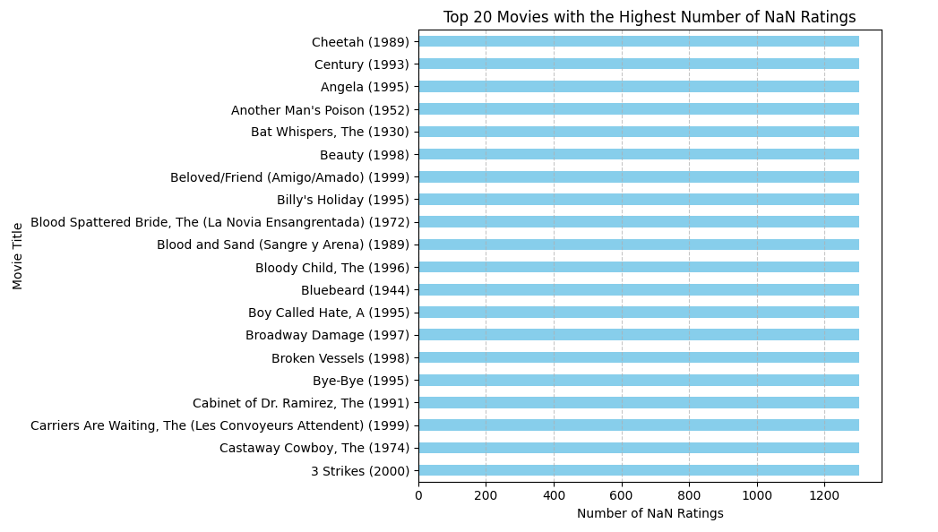
No of Nan entries v/s Movies:

Slide 6
Data Preprocessing:
We have used three different methods to fill the nan values in the matrix:
1. Replacing nan values by mean of the ratings of the corresponding movie
2.Replacing nan values by zero
3.Generating values for nan using a decision tree:
As decision tree cannot handle missing values,first simple imputer’s mean strategy is used to fill the missing values,then the model iterates over each movie,identifying missing ratings for each movie,and training a decision tree model over available ratings. Finally it predicts the missing ratings for each movie using the trained model.
Observation: Filling NaN with decision tree gave us better result

Slide 7
Method 1:Neighbourhood based Collaborative Filtering:
In this method we mainly concentrated on user-user based approach
Under this approach we explored 4 different similarity functions:
Cosine similarity
Pearson Correlation
Weighted Pearson Correlation
Improved Triangular similarity complemented with user rating preference(ITR)
Observations:
Of all these methods,the Pearson Correlation gave us the best results(considering top 1307 users )

Slide 8
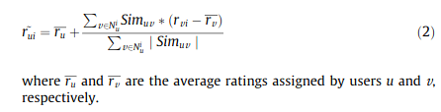
Similarity functions Implementations:
The following steps were followed for all the similarity functions:
1.First we calculated the similarity of each user with every other users present in the dataset using the specific similarity functions,this similarities are stored in the similarity_matrix
2.Now when a new user with its ratings for a few movies enter the dataset ,the new users similarities with all the users are calculated.
3.Based on similarity score the users are sorted in descending order
4.Now using our prediction function and the top users similarity score ,ratings for movies which are not rated by the new user are calculated,among them top 5 movies are being recommended
This is the prediction function used:

Slide 9


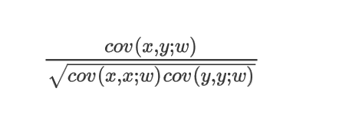
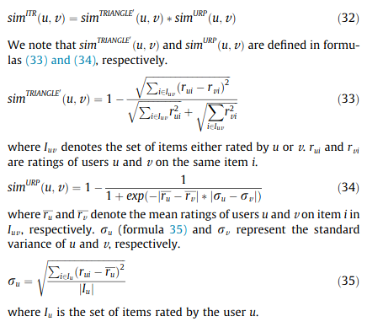
1.Cosine Similarity:
2.Pearson Co-relation:
3.Weighted Pearson:
4.Improved Triangle Similarity

Slide 10

Validation of the Model:
1.The pivot table is splitted into test-train model (80% and 20 %)
2.Using the ratings of the movie that fall in the trained set of a user and the users similarity with other users
We predict the ratings of the movie in the train set
3.These predicted ratings are stored in the predicted array
4.Comparing between the original ratings of the movie in th test set and their predicted ratings ,we
Calculate the MSE,MAE,RMSE
Observation 1:(for the top 1307 users and using the prediction function we stated previously pearson co-relation gave use the best results)
Observation 2:(for top 300 users and using the prediction function below) ITR gave us the best results

Slide 11




Comparing Different similarity function results:
1.Cosine similarity:
2.Pearson Co-relation:
3.Weighted Pearson:
4.ITR

Slide 12
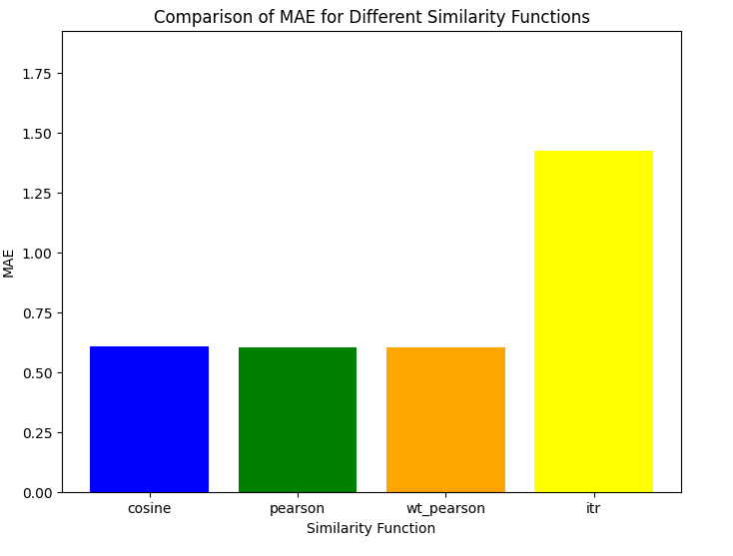
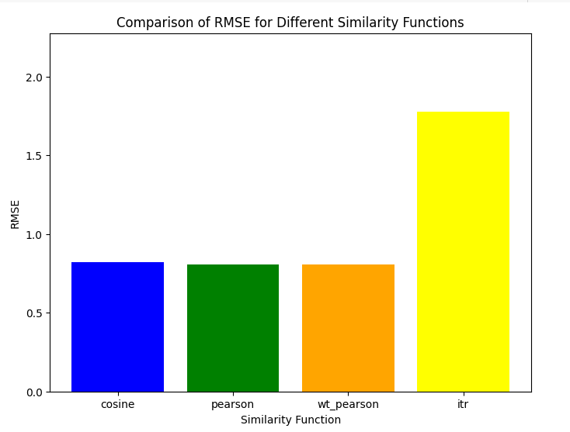
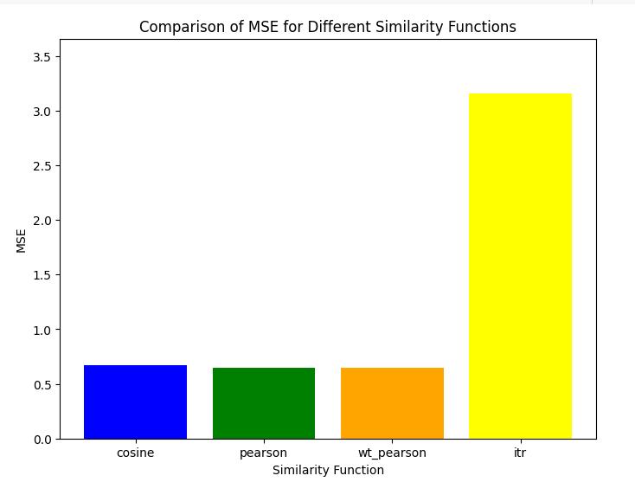
1.MAE:
2.RMSE:
3.MSE:

Slide 13
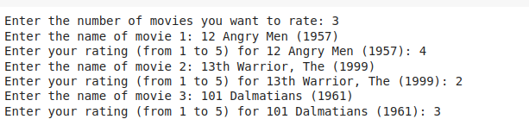
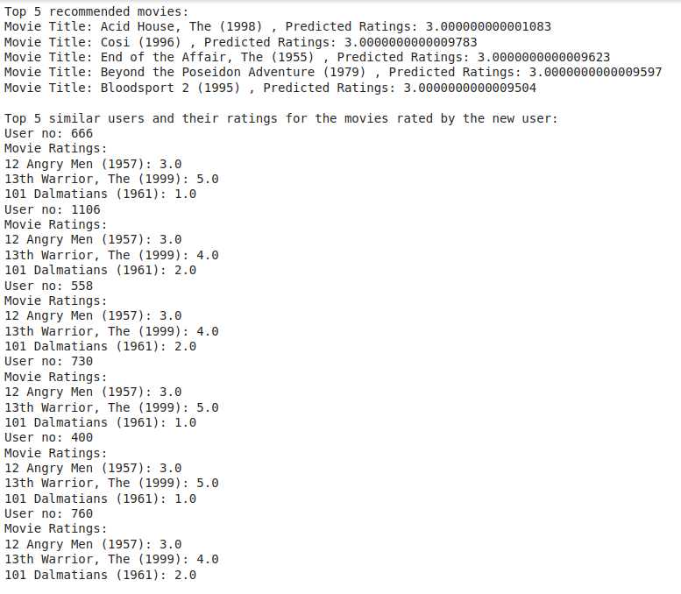
Recommendation:
Input
Output:

Slide 14
Reduced SVD and K-means implementation
Data Preprocessing:
We have used three different methods to fill the nan values in the matrix:
1. Replacing nan values by mean of the ratings of the corresponding movie
2. Replacing nan values by zero
3. Filling nan values by Linear Regression
In linear regression data simple imputer’s mean strategy is used to fill the missing values, data is splitted into training and test data set ,training data and the test data contains ratings filled by the imputer. Using linear regression values are predicted and replaced in the original user movie rating matrix.
Observation: Filling NaN with Linear Regression provided better accuracy.

Slide 15
Singular Value Decomposition (SVD)
The values in the user-item matrix obtained from the data are superficial. Singular value decomposition(SVD) decomposes a matrix into three other matrices and extracts the factors from the factorization of a high-level (user-item-rating) matrix. We first performed SVD to obtain the latent representations of each user.
On performing SVD, we obtain three matrices, such that
Where,
U = User matrix, where each row represents the latent factor of that particular user,
S = Matrix of singular values, where each value depict the weight or the importance of each latent factor, and
V = Item matrix, where each row represents the latent factor of that particular item(movie).

Slide 16
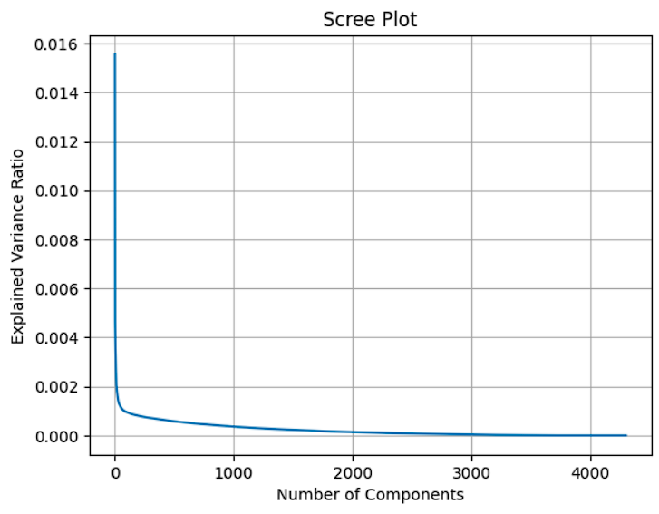
Reduced SVD
Reduced SVD is performed to reduce the dimensionality of the three matrices. We use a scree plot to determine the number singular values to retain.
In the scree plot, for each singular value, the proportion of variance in the original data that is captured by that singular value is plotted.It displays the singular values in decreasing order and we can visually inspect the "elbow" or point where the rate of decrease in singular values starts to level off. The value at this point is used as the number of singular values to retain.

Slide 17
K-Means Clustering
Using the latent representations, we performed K-means clustering for grouping similar users. The clusters were initialized using the Naive Sharding Initialization method (https://www.kdnuggets.com/2017/03/naive-sharding-centroid-initialization-method.html).
It consists of the following steps:
Sum the attribute (column) values for each instance (row) of a dataset, and prepend this new column of instance value sums to the dataset
Sort the instances of the dataset by the newly created sum column, in ascending order
Split the dataset horizontally into k equal-sized pieces, or shards
For each shard, sum the attribute columns (excluding the column created in step 1), compute its mean, and place the values into a new row; this new row is effectively one of the centroids used for initialization
Advantages of the Naive Sharding approach is that the selection of centroids is more balanced across the data, which leads to faster convergence and more stable clustering solutions.

Slide 18
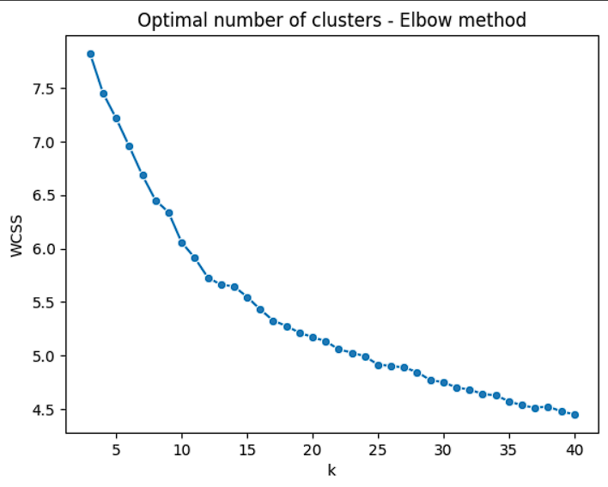
Determining Optimal number of Clusters
Two approaches were used to find the optimal number of clusters:
Elbow method:
Elbow method is used for optimal number of clusters in a dataset. It involves plotting the variance explained by different numbers of clusters and identifying the “elbow” point, where the rate of variance decreases sharply levels off, suggesting an appropriate cluster count for analysis or model training.

Slide 19
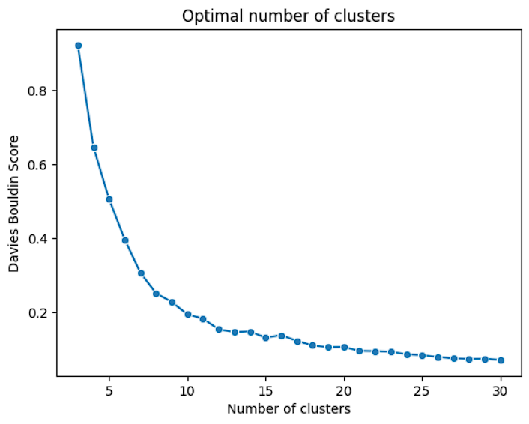
Davies-Bouldin Index:
The Davies-Bouldin index measures the average similarity between each cluster and its most similar cluster, where similarity is based on the ratio of within-cluster and between-cluster distances. Lower values of the Davies-Bouldin index indicate better clustering, with values closer to zero indicating tighter and more well-separated clusters.

Slide 20
Recommendations
We have divided the existing users into different clusters.
A new user enters and provides their ratings for some movies.
Based on the ratings, distance between the new user’s ratings and the cluster centroids are calculated. The user is assigned to that cluster in which the distance is minimum.
The average ratings given for each movie by the users in that cluster is calculated.
The top 5 movies with the highest average ratings are recommended to the user.
movie_names = ['James and the Giant Peach (1996)', 'Cinderella (1950)', 'Wizard of Oz, The (1939)', 'Schindler\'s List (1993)', 'Star Wars: Episode IV - A New Hope (1977)']
user_ratings = [3, 4, 4, 5, 4]

Slide 21
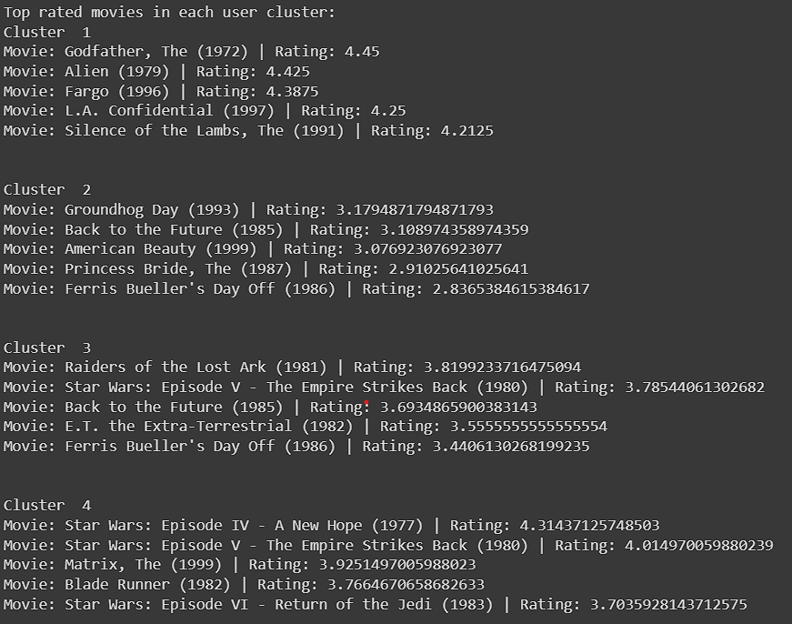
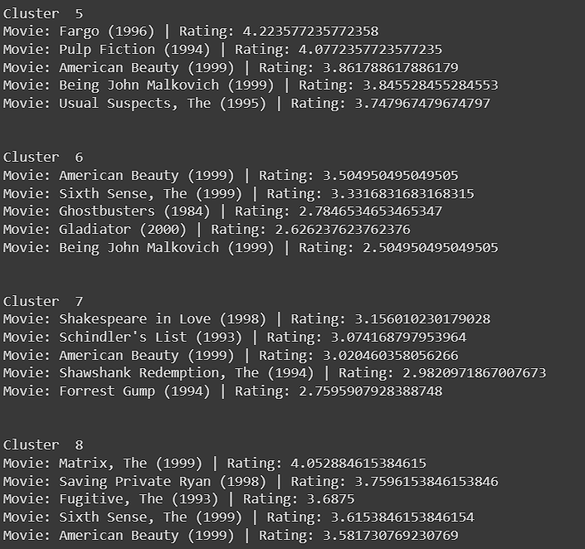

Slide 22
Results:
MovieID | Title | Genres | Rating
343 | 347 | Bitter Moon (1992) | Drama | 4.646154
116 | 118 | If Lucy Fell (1996) | Comedy|Romance | 4.625000
641 | 647 | Courage Under Fire (1996) | Drama|War | 4.580645
543 | 547 | Surviving the Game (1994) | Action|Adventure|Thriller | 4.517241
515 | 519 | Robocop 3 (1993) | Sci-Fi|Thriller | 4.513889

Slide 23
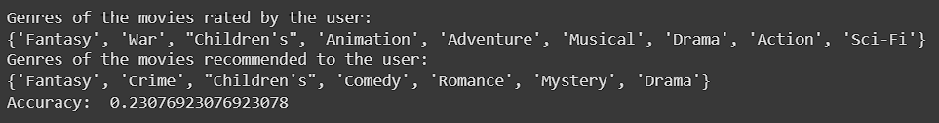
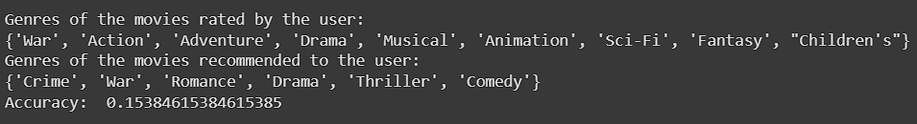
Validation:
The recommendations have been validated using the genres of the rated movies and the recommended movies. First, we compute the sets containing the genres of the rated movies and the recommended movies. Then using the Jaccard similarity, we compute the similarities between both the sets.
Filling NaN with zero:
Filling NaN with mean:

Slide 24
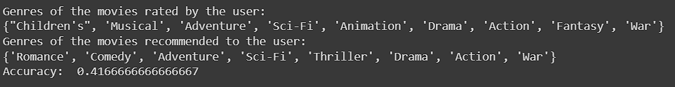
c. Filling NaN using Linear Regression:

